Slide 1
ESHAN COLLEGE OF ENGINEERING MATHURA
ER. SHAILESH KUMAR
ASST. PROFESSOR
DEPARTMENT OF CIVIL ENGINEERING

Slide 2
What is Mechanics?

Slide 3
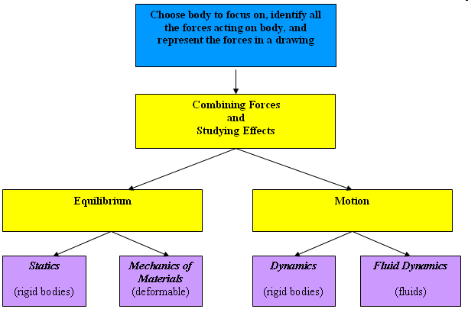

Slide 4
What’s the big deal with E. Mech?
In principle, like cricket, it’s a simple game.
Simply, force balance and moment balance.
What is the need for an elaborate course?
The basic rules are simple but there are many intricacies. Multi-body interactions can be very complex.
A good understanding of fundamentals goes a long way in solving such complex problems.
Concepts of appropriate Free Body Diagrams and equations of equilibrium (motion in dynamics) will be indispensable in later studies of mechanical engineering.

Slide 5
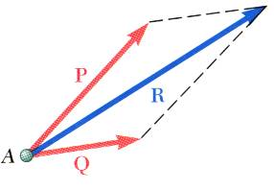
Fundamental Principles
Parallelogram Law
Parallelogram Law

Slide 6
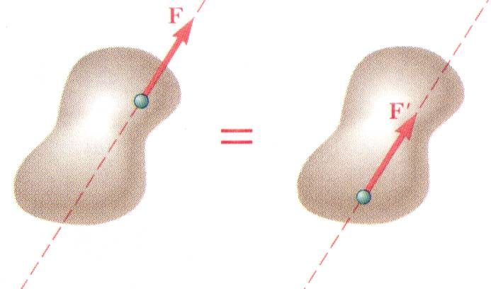
Principle of Transmissibility

Slide 7
Newton’s Laws

Slide 8
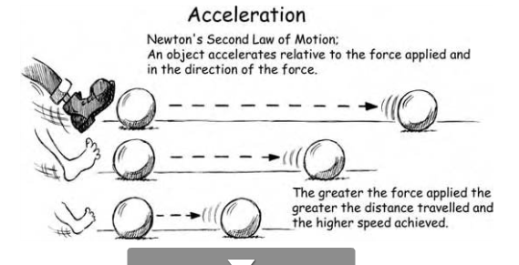

Slide 9
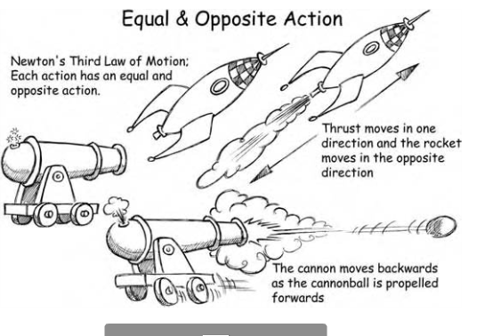
Newton’s Laws

Slide 10
Newton’s third law on a lighter note
"for every action there is an equal and opposite reaction" and we shouldn't forget the laws of cause and effect, karma or whatever

Slide 11
Systems of Units
Systems of Units
Three of the kinetic units, referred to as basic units, may be defined arbitrarily. The fourth unit, referred to as a derived unit, must have a definition compatible with Newton’s 2nd Law,
International System of Units (SI): The basic units are length, time, and mass which are arbitrarily defined as the meter (m), second (s), and kilogram (kg). Force is the derived unit,

